Slide 1
Some Exercises from the book¹
Learning responsibility rests on you
Chapter 5: Discrete Probability Distributions
Pages: 306-308 and 320-321
¹Fundamentals of Statistics, Michael Sullivan III, 4th edition,
ISBN-10: 032183870X, ISBN-13: 978-0321838704.

Slide 2
Example :
Determine the required value of the missing probability to make the distribution a discrete probability.
x | P(x)
3 | 0.4
4 | ?
5 | 0.1
6 | 0.2
P(4)= 1- (0.4 + 0.1 + 0.2 ) = 0.3

Slide 3
Example :

Slide 4
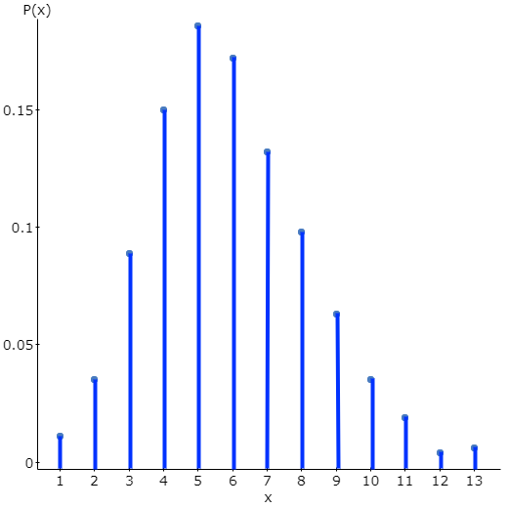
(a) Verify that this is a discrete probability distribution.
Each probability is between 0 and 1, they add up to one.
(b) Draw a line graph of the probability discrete distribution. Describe the shape of the distribution.
0 1 2 3 4 5 6 7 8 9 10 11 12
x

Slide 5
(c) Compute and interpret the mean of the area of the random variable X.
persons
(d) Compute the standard deviation of the random variable X.
persons
(e) What is the probability that eight people are waiting in line for lunch?
P(X = 8) = 0.063
(f) What is the probability that 10 or more people are waiting in line for lunch? Would this be unusual?
P(X ≥ 10) = P(X = 10) + P(X = 11) + P(X = 12) = 0.029
< .05
yes it is unusual

Slide 6
Example :
Rental units The probability histogram represents the number of rooms in rented housing units in 2009.

Slide 7
(a) What is the probability that a randomly selected rental unit has five rooms?
P(X =5 ) = 0.233
(b) What is the probability that a randomly selected rental unit has five or six rooms?
P(X =5 or 6 ) = P(5) + P(6) = 0.233 + 0.108 = 0.341
(c) What is the probability that a randomly selected rental unit has seven or more rooms?
P(X =7 or more ) = P(7)+P(8)+P(9) = 0.037 + 0.013 + 0.005 = 0.055
(d) If the rental unit is randomly selected, how many rooms would you expect the unit to have?
$μ=4.32$ rooms

Slide 8
Example :
Smokers According to the American Lung Association, 90% of adult smokers started smoking before turning 21 years old. Ten smokers 21 years old or older are randomly selected, and the number of smokers who started smoking before 21 is recorded.
(a) Explain why this is a binomial experiment.
This is a binomial experiment because:
A number n= 10 of random selections (or trial).
For each trial, there are two possible mutually exclusive outcomes: started smoking before 21 years old or after 21 years old.
p=P(an adult smokers started smoking before turning 21 years old)=.9
X: number of smokers who started smoking before 21 among n=10 is recorded.
X~Binomial(10,.9)

Slide 9
(b) Find and interpret the probability that exactly 8 of them started smoking before 21 years of age.
P(X =8) = binompdf (10,0.90,8) = 0.1937
(c) Find and interpret the probability that fewer than 8 of them started smoking before 21 years of age.
P(X<8) = P(X ≤ 7) = binomcdf (10,0.9,7) = 0.0702

Slide 10
(d) Find and interpret the probability that at least 8 of them started smoking before 21 years of age.
P(X ≥ 8) = 1 - binomcdf (10,0.9,7) = 0.9298
(e) Find and interpret the probability that between 7 and 9 of them, inclusive, started smoking before 21 years of age.
P(X = 7) + P(X = 8)+ P(X = 9) = 0.6385

Slide 11
(f) What is the mean (expected) number of people started smoking before 21 years of age among the randomly selected n=10 individuals?
$μ=n∙p=10∗0.9=9$ persons
(g) What is the variance of the number of people started smoking before 21 years of age among the randomly selected n=10 individuals?
$σ^{2}=n∙p∙\left(1−p\right)=10∗0.9∗(1−0.9)=0.9$ persons²
(h) What is the standard deviation of the number of people started smoking before 21 years of age among the randomly selected n=10 individuals?
$σ=\sqrt{n∙p∙\left(1−p\right)}=\sqrt{10∗0.9∗(1−0.9)}=\sqrt{0.9}=.94868$ persons

Slide 12
Example :
P(X =4) = binompdf (10,0.267,4) = 0.1655

Slide 13
P(X< 3) = P(X ≤ 2 ) = binomcdf (10,0.267,2) = 0.4752
Probability an individual
will cover her or his
mouth
P(X ≤ 4 ) = binomcdf (10,0.733,4) = 0.0272
< .05
Answer: Yes

Slide 14
Example :
P(X = 2) = binompdf (15,0.047,2) = 0.124
P(X<3)=P(X ≤ 2) = binomcdf (15,0.047,2) = 0.9691

Slide 15
P(X > 4 ) = 1- P(X ≤ 4)
= 1 - binomcdf (15,0.047,4) = 0.0005
< .05
Answer: Yes

Slide 16
End of examples for chapter 5

